Slide 1
Interrupt-driven client-server communication for led control

Slide 2
INTRODUCTION
In embedded systems, efficient communication between client and server plays a crucial role in real-time applications. This project integrates two systems to demonstrate an interrupt-driven client-server communication model for LED control.
The first system (Client) involves a Raspberry Pi configured to detect GPIO interrupts. Upon triggering an interrupt, the client prompts the user to choose an operation, such as turning an LED on or off. The selected action is sent to the second system (Server) over the TCP/IP protocol using sockets. The server receives the data, processes it, and interacts with its GPIO driver to control the LED state. This combined setup highlights seamless real-time interaction, network communication, and hardware control across two boards.

Slide 3
OBJECTIVES
Detect GPIO interrupts on the client side
Communicate user commands to the server via TCP/IP.
Control LED state on the server side.
Ensure real-time hardware interaction.

Slide 4
METHODOLOGIES
CLIENT SIDE:-
Client-Side Interrupt Handling: Configure the GPIO pin on the Raspberry Pi to trigger an interrupt on a state change (e.g., falling edge). This interrupt is handled by the client _ driver.
User Input: When the interrupt is triggered, the client _ user program prompts the user to select an operation, such as turning the LED ON or OFF.
Data Transmission: The selected operation is transmitted from the client to the server using the TCP/IP protocol, with sockets facilitating reliable communication

Slide 5
METHODOLOGIES
SERVER SIDE:-
Server Processing: The server _ user receives the data, processes the command, and sends it to the server _ driver.
LED Control: The server _ driver updates the GPIO pin state to control the LED (turning it ON or OFF) based on the received command.

Slide 6
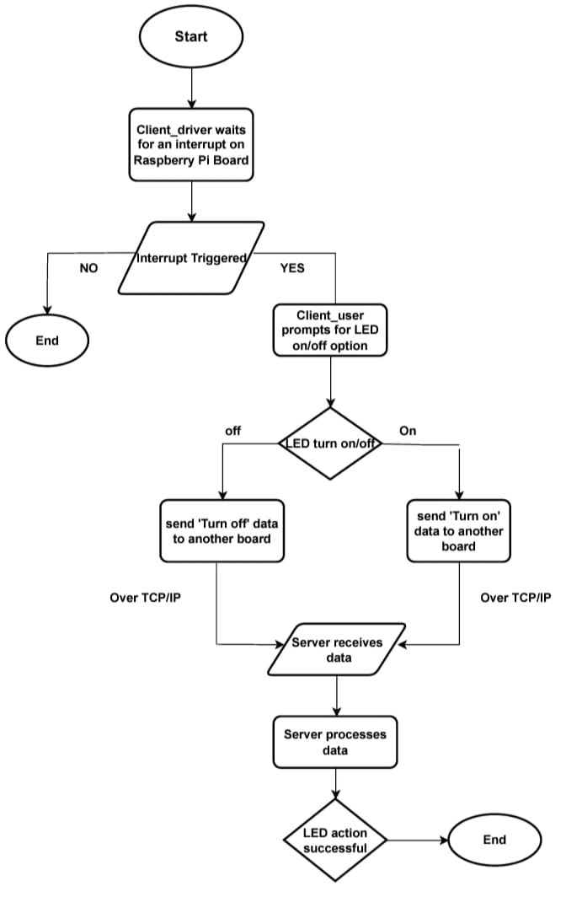
FLOW DIAGRAM

Slide 7
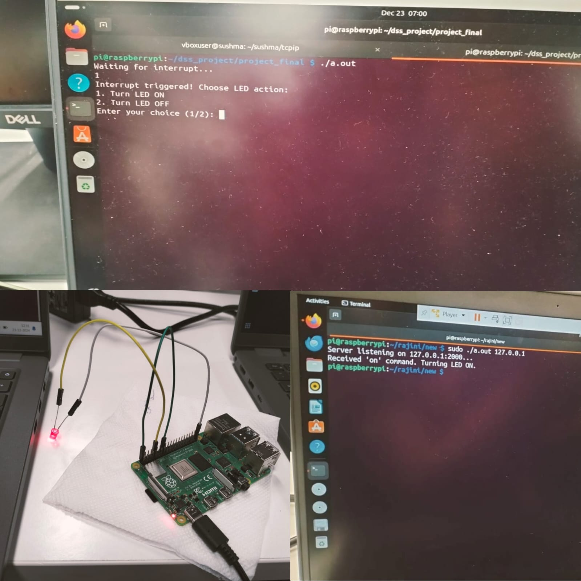
OUTPUT ACHEIVED

Slide 8
CONCLUSION
In conclusion, the project successfully demonstrates how to control an LED using GPIO interrupts. An interrupt is triggered to initiate actions, and a user-space application communicates with the kernel to control the LED. This approach shows how hardware, the kernel, and software can collaborate to respond to events.

Slide 9
THANK YOU

